Slide 1


PostgresSQL
vs
Firebird
Cleisson Vieira Raimundi
Nicolas Ribas

Slide 2
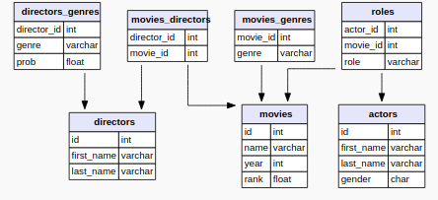
Estrutura IMDB_IJS

Slide 3
Registros inseridos nas tabelas
Actors: 817718
Directors: 86880
Directors_genres: 156562
Movies: 388269
Movies_directors: 371180
Movies_genres: 395119
Roles: 3431966

Slide 4
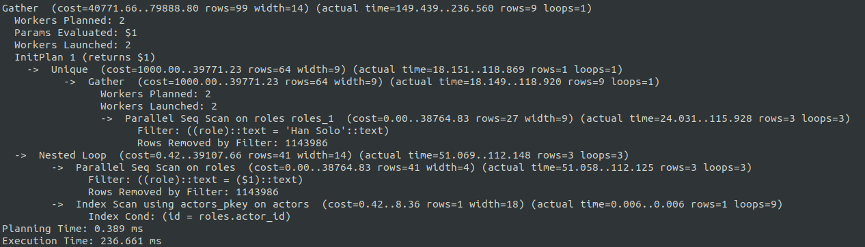
Consultas PostgresSQL
Join sem índice:
Otimizado; SELECT first_name, last_name FROM actors JOIN roles on id = actor_id WHERE role = ‘Han Solo’; (Times-> Planning Time: 0.303 ms | Execution: 137.559 ms)
Não Otimizado: SELECT first_name, last_name FROM (select * from actors, roles) as tabela
where tabela.id = tabela.actor_id and role = (select distinct role from roles where role = 'Han Solo'); (Times-> Planning Time: 0.389 ms | Execution: 236.661 ms)

Slide 5
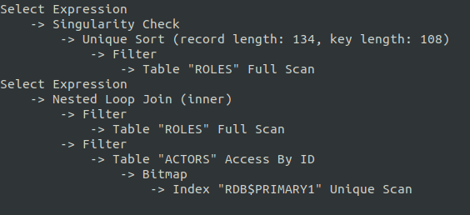
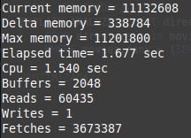
Consultas Firebird
Join sem índice:
Otimizado; SELECT first_name, last_name FROM actors JOIN roles on id = actor_id WHERE role = ‘Han Solo’; (Elapsed time: 1.596 sec)
Não Otimizado: SELECT first_name, last_name FROM (select * from actors, roles) as tabela
where tabela.id = tabela.actor_id and role = (select distinct role from roles where role = 'Han Solo'); (Elapsed time: 3.206 sec)

Slide 6
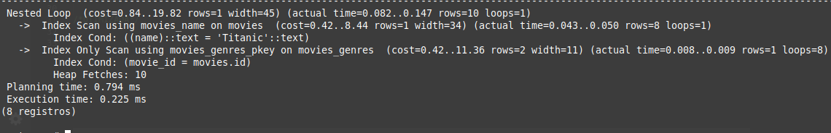
Consultas PostgresSQL
Join com índice:
Otimizado: SELECT * FROM movies_genres JOIN movies on id = movie_id WHERE name = 'Titanic';

Slide 7
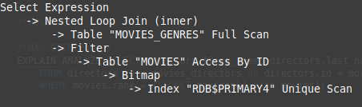
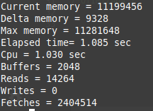
Consultas Firebird
Join com índice:
Otimizado: SELECT * FROM movies_genres JOIN movies on id = movie_id WHERE name = 'Titanic';

Slide 8
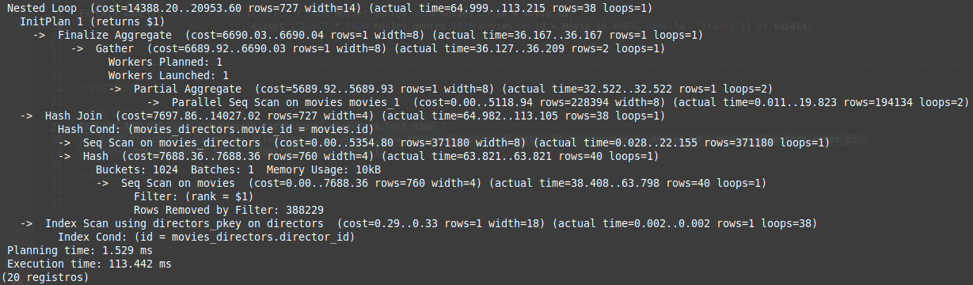
Consultas PostgresSQL
Com subconsultas:
Otimizado: SELECT directors.first_name, directors.last_name FROM directors join movies_directors on directors.id = movies_directors.director_id join movies on movies.id = movies_directors.movie_id WHERE movies.rank = (SELECT max(rank) from movies);

Slide 9
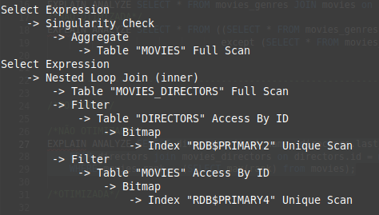
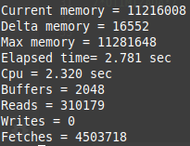
Consultas Firebird
Com subconsultas:
Otimizado: SELECT directors.first_name, directors.last_name FROM directors join movies_directors on directors.id = movies_directors.director_id join movies on movies.id = movies_directors.movie_id WHERE movies.rank = (SELECT max(rank) from movies);

